Slide 1

Healthcare Provider Fraud Detection Project
Uncovering Anomalies, Protecting Patients & Pockets
By: Aisha El Saadany - Habiba Amr - Omar Hatem - Ali Hesham - Abdelrahman Abualhuda
Notes:
Today, I’ll present our work on detecting fraudulent providers using aggregated provider data. We’ll go through data preparation, modeling, evaluation, and insights.

Slide 2


The Cost of Deception: Why Fraud Detection Matters
Financial Impact
Patient Safety
Healthcare fraud costs billions annually, driving up premiums and straining public funds.
Fraudulent practices can compromise patient care, leading to unnecessary procedures or incorrect diagnoses.
Erosion of Trust
Maintaining integrity in the healthcare system is crucial for public confidence.

Slide 3
Project Objective:
Build a data-driven fraud detection pipeline
Combine multi-table Medicare data into provider-level records
Handle severe class imbalance (~10% fraud)
Train and compare multiple ML models
Deliver meaningful insights for real Medicare investigators

Slide 4

Data Preprocessing: Preparing for Analysis
Missing Value Analysis
Identified columns with missing values.
Developed imputation strategy based on data characteristics.
Data Type Conversions
Converted object columns to datetime for temporal analysis.
Transformed columns to numeric or nominal types as appropriate.
Preserved crucial information by avoiding complete removal.
Strategic Imputation
Imputed missing values with 0 for key columns like "DeductibleAmtPaid".
Maintained data integrity while effectively handling gaps.
Outcome
Dataset is now ready for feature engineering and modeling.
Achieved a balanced approach between data completeness and information preservation.

Slide 5

Data Preprocessing (Continued)
Data Encoding & Cleaning
Aggregation Strategy
"PotentialFraud" column converted from yes/no to 0/1 for analysis.
Complex financial and procedural claim information was summarized.
Missing and duplicate values were systematically removed.
Dataset prepared for the subsequent aggregation stage.
Claim duration (in days) was calculated for each record.
Data grouped by provider and potential fraud status for granular insight.
Unique diagnosis and procedure codes were calculated to capture breadth of services.
Results Section:
Final aggregated dataset comprises 9,860 rows.
The dataset now contains 11 columns in total.
Key identifiers for exploration phase: "Provider" and "Potential Fraud".

Slide 6

Data at a Glance: Fueling Our Analysis
1
Provider-Level Features
provider_model_ready_unscaled.csv: Contains preprocessed features for each provider, ready for model training.
2
Aggregated Claims Data
provider_aggregated_data.csv: Comprehensive dataset with summarized claims and beneficiary information.
These datasets serve as the foundation for identifying suspicious patterns and potential fraudulent activities.

Slide 7
Datasets & Structure
We combined information from 4 datasets: Beneficiary, Inpatient, Outpatient, and Provider Labels.
Datasets connect through BeneID (patients) and Provider (hospitals/clinics).
Key fields include claim dates, reimbursed amounts, deductibles, and diagnosis/procedure codes.
he final label, PotentialFraud, is mapped to 0 (No Fraud) and 1 (Fraud) for modeling.

Slide 8
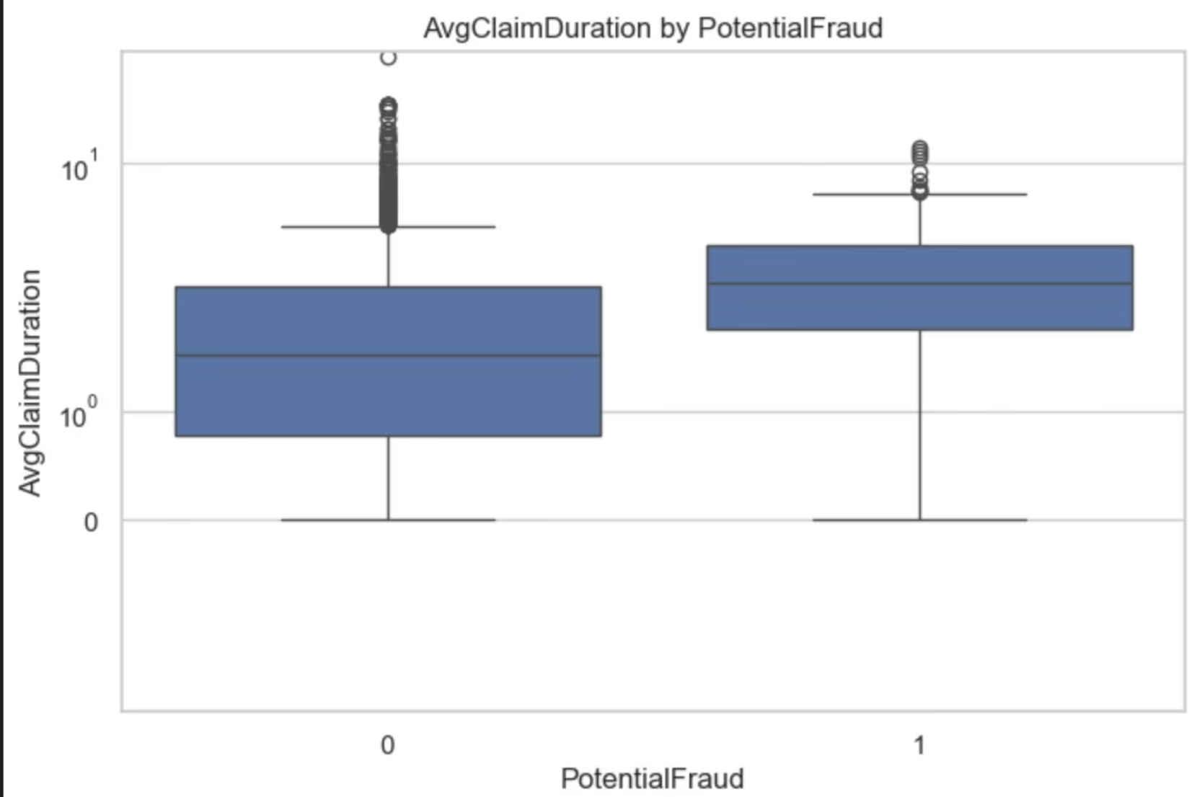
Cleaning & Structuring the Claims Data
Standardized all claim dates and monetary fields for consistency
Addressed missing values: filled deductible gaps with 0 and removed claims with invalid date ranges
Combined inpatient & outpatient data, then aggregated per provider to compute:
-Total reimbursement amounts
-Number of claims
-Unique diagnoses & procedures
-Average claim duration
Engineered additional features such as claims per beneficiary, claim-to-deductible ratios, and claims per day
Applied log transforms to fix heavy right-skew in financial variables and stabilize variance for modeling

Slide 9
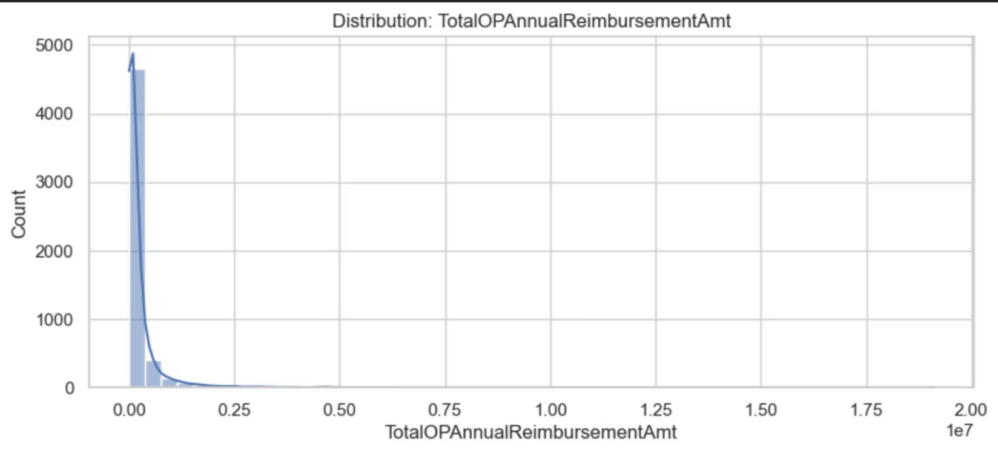
Fraud Distribution & Metric Choice
Fraudulent providers represent only ~10–13% of the dataset.
This imbalance makes accuracy misleading, since predicting “non-fraud” yields ~90% accuracy while detecting no fraud at all.
To correctly evaluate fraud detection, we prioritize:
-Precision – correctness of fraud predictions
-Recall – how many actual frauds we catch
-F1-score – balance between precision & recall
-PR-AUC – best metric for highly imbalanced classification
These metrics focus on the model’s ability to identify true fraud cases rather than overall accuracy.

Slide 10
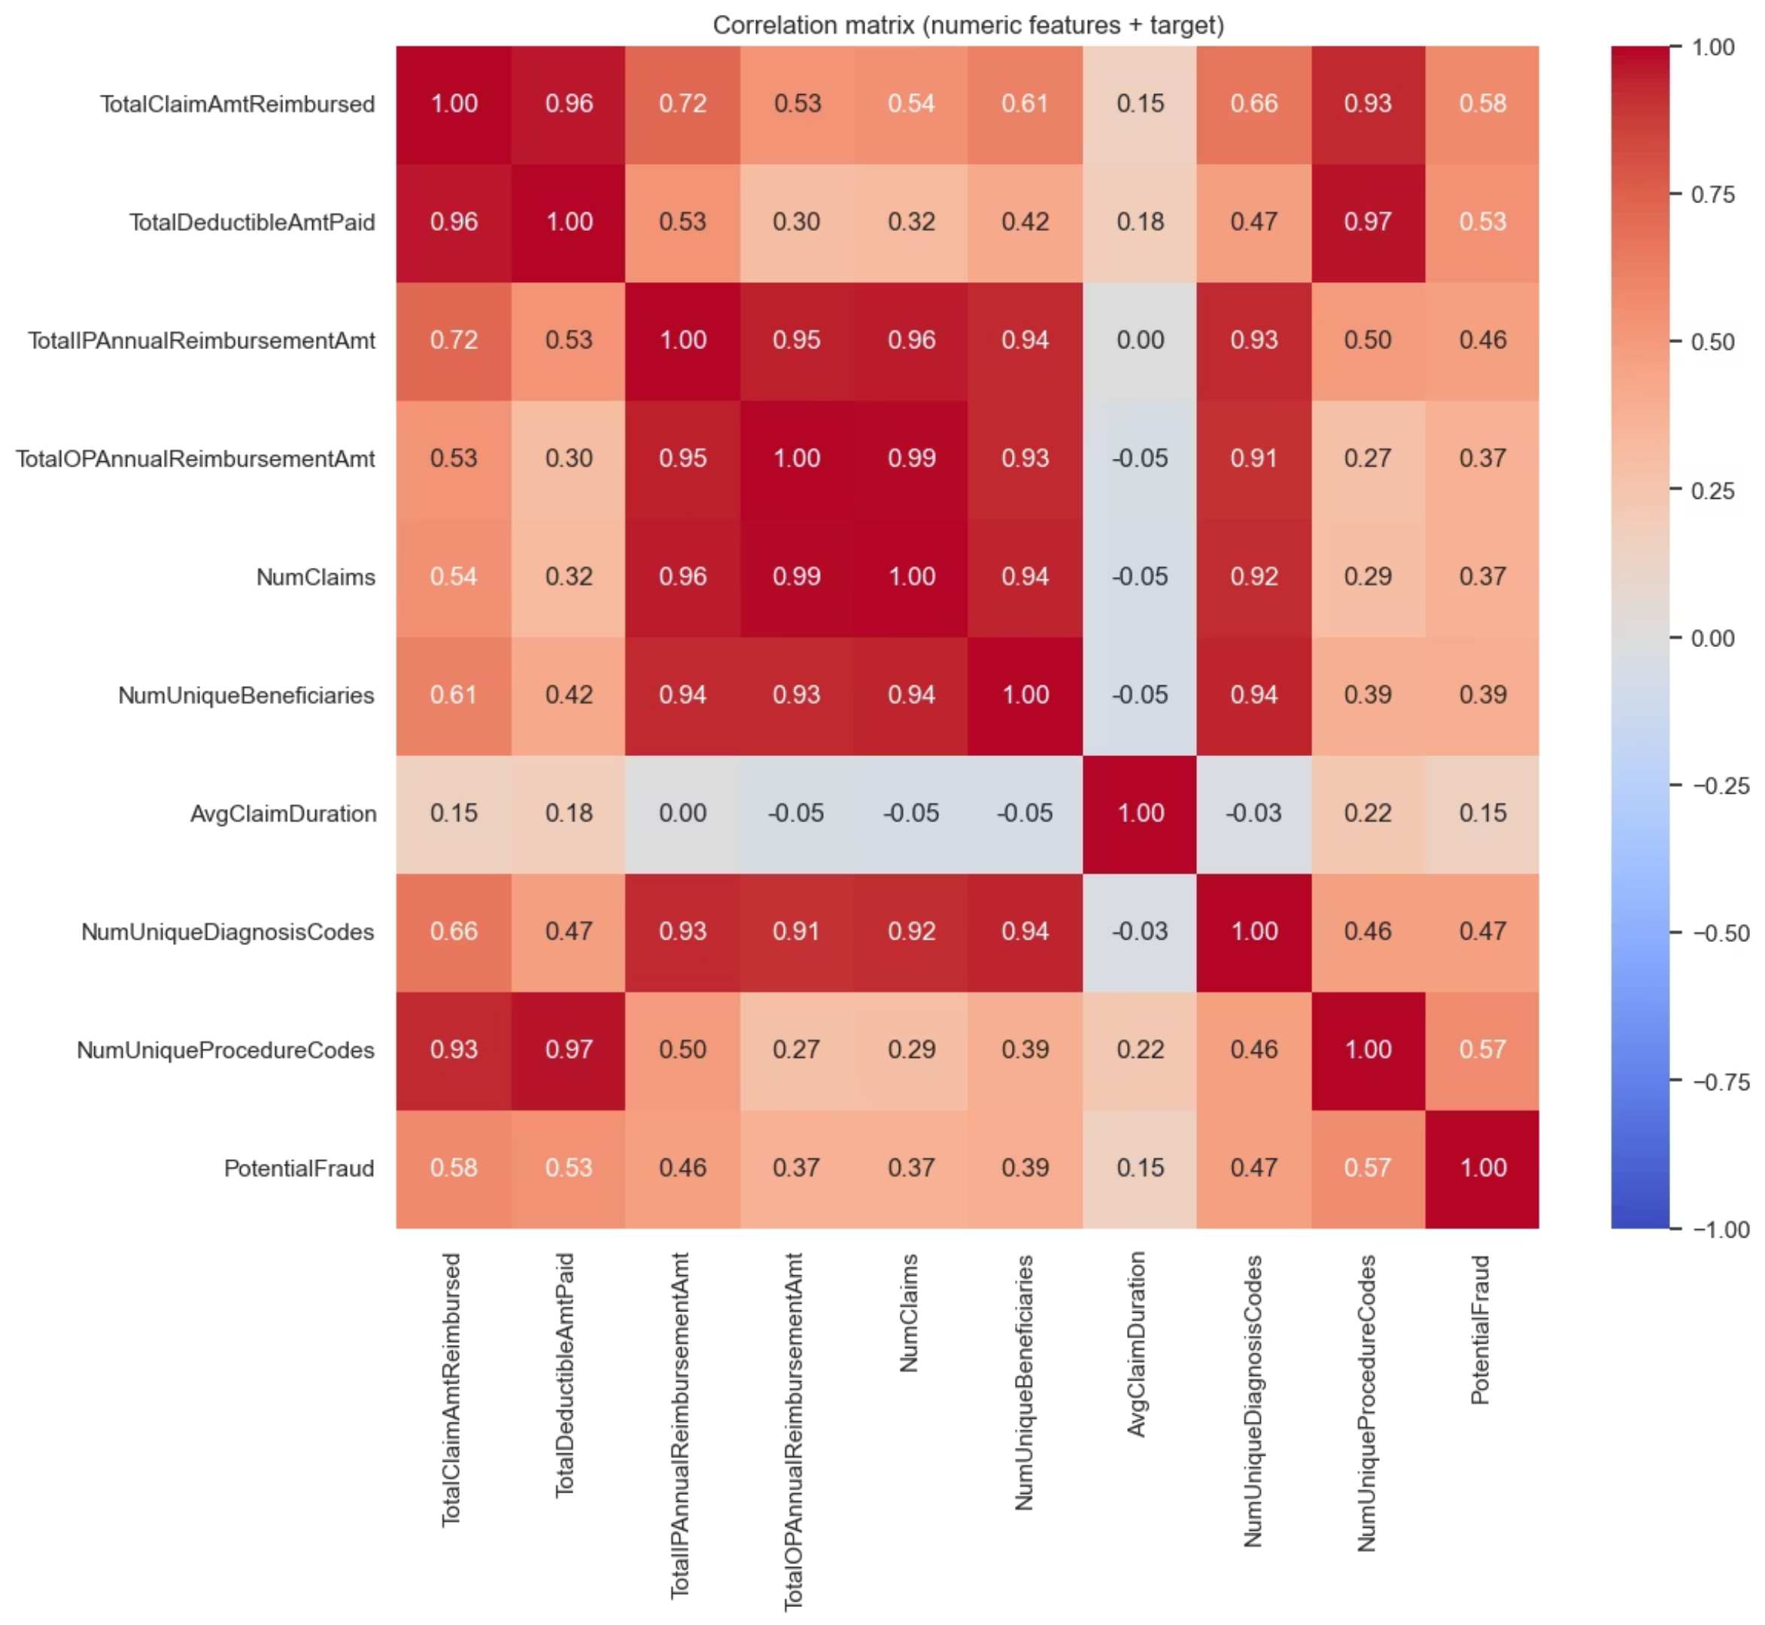

Slide 11




Strategic Approach: Our Modeling Lineup
We employed a diverse set of machine learning models to capture various patterns of fraudulent behavior.
Logistic Regression
A strong baseline for binary classification, providing interpretable results.
Random Forest
An ensemble method known for its robustness and ability to handle complex interactions.Handles non-linear patterns, feature importance
XGBoost
A highly efficient and powerful gradient boosting algorithm, High performance on imbalanced datasets

Slide 12
Separate your dataset into training data (to teach the model) and testing data (to evaluate it).
80/20 split:
80% for training, 20% for testing.
Ensures enough data to train while keeping some unseen data for evaluation.
Stratified by PotentialFraud:
Because fraud cases are rare, stratification ensures both training and test sets have roughly the same proportion of fraud/non-fraud cases.
Prevents models from being biased toward the majority (non-fraud) class.
1
2
3
4
5
Features
Train/Test Split (80/20, stratified)
Model Training
Predictions on Test Set
Evaluation (Accuracy, Precision, Recall, F1, PR-AUC, ROC-AUC)
├─ Logistic Regression
├─ Random Forest
└─ XGBoost

Slide 13
Model Performance (Test Set)
Model
Accuracy
Precision
Recall
F1-Score
ROC-AUC
PR-AUC
0
XGBoost
0.906654
0.000000
0.000000
0.000
0.821459
0.526082
1
Random Forest
0.906654
0.000000
0.000000
0.000
0.873825
0.493465
2
Logistic Regression
0.317930
0.009245
0.059406
0.016
0.126381
0.052222
XGBoost achieved the highest PR-AUC → best model
Random Forest performed moderately well
Logistic Regression had lowest recall & PR-AUC

Slide 14
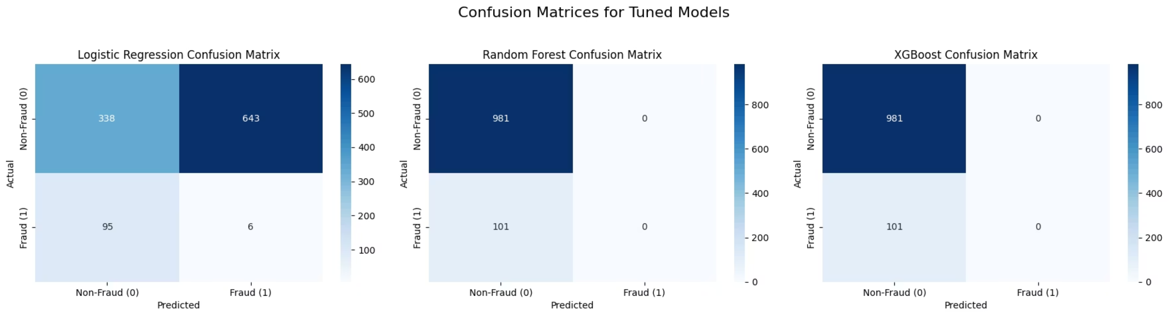
Decoding Outcomes: Confusion Matrices
To ensure a robust assessment, we used a suite of metrics critical for imbalanced datasets common in fraud detection.
XGBoost → lowest false negatives (critical for fraud detection)
Random Forest → balanced but slightly weaker
Logistic Regression → highest error rates
Confusion matrices provide a detailed breakdown of model predictions, helping us understand specific types of errors.

Slide 15
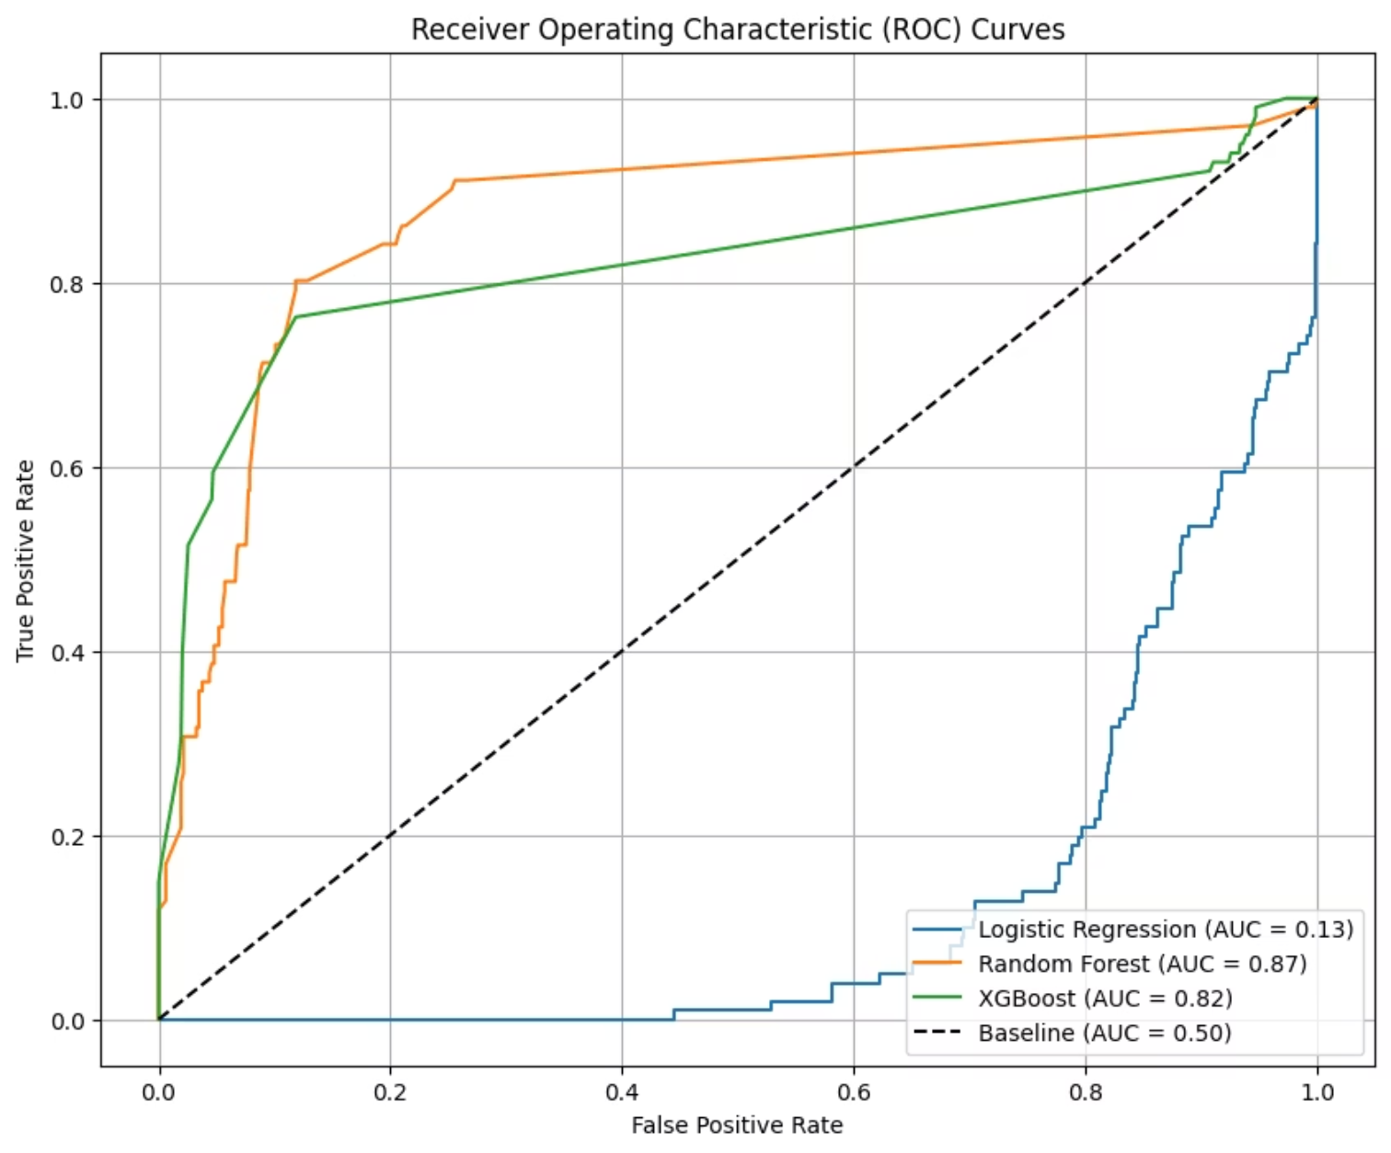
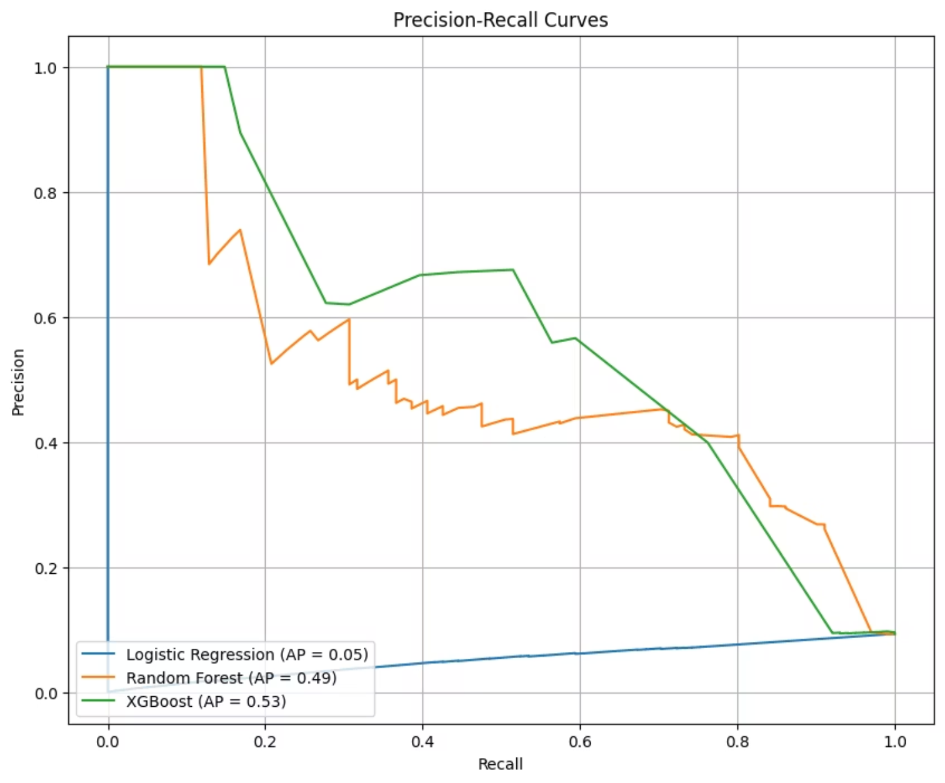
Visualizing Performance: ROC and PR Curves
ROC Curves
Precision-Recall Curves
Illustrate the true positive rate against the false positive rate, demonstrating classifier effectiveness at all classification thresholds.
Crucial for imbalanced datasets, highlighting the trade-off between precision and recall for different thresholds.
XGBoost shows the largest area under curve
XGBoost dominates the PR curve
All models > 0.70 ROC-AUC → decent separation
Shows strongest balance of precision vs recall
Reinforces selection of XGBoost as final model

Slide 16

The Champion Model: XGBoost Leads the Way
XGBoost consistently delivered the highest performance across key metrics, making it our top recommendation for fraud detection.
With superior ROC-AUC and PR-AUC scores, XGBoost effectively balances precision and recall, crucial for minimizing both missed fraud and false accusations.
Key Strengths:
High predictive accuracy
Robustness to complex data patterns
Efficient handling of large datasets

Slide 17
Conclusion & Insights
1️⃣ Key Takeaways
2️⃣ Insights from Results
Data Preparation:
Random Forest and XGBoost performed better in detecting fraudulent cases compared to Logistic Regression.
Carefully split the dataset into training and test sets (80/20) with stratification to handle imbalanced fraud cases.
Trade-off: High Recall often comes with lower Precision. Choosing the right threshold is important based on business needs.
Modeling Approach:
Tested Logistic Regression, Random Forest, and XGBoost to compare performance.
Importance of Features: Certain features were more influential in predicting fraud (if you did feature importance analysis, mention top 2–3).
Selected models based on their ability to handle rare events and provide interpretability.
Evaluation Strategy:
3️⃣ Implications
Focused on Precision, Recall, F1-score, PR-AUC, and ROC-AUC rather than accuracy because fraud cases are rare.
Using machine learning for fraud detection can significantly reduce financial losses by identifying suspicious transactions early.
Ensured fair evaluation using stratified test sets.
The pipeline can be scaled and updated with new data for real-time detection.

Slide 18
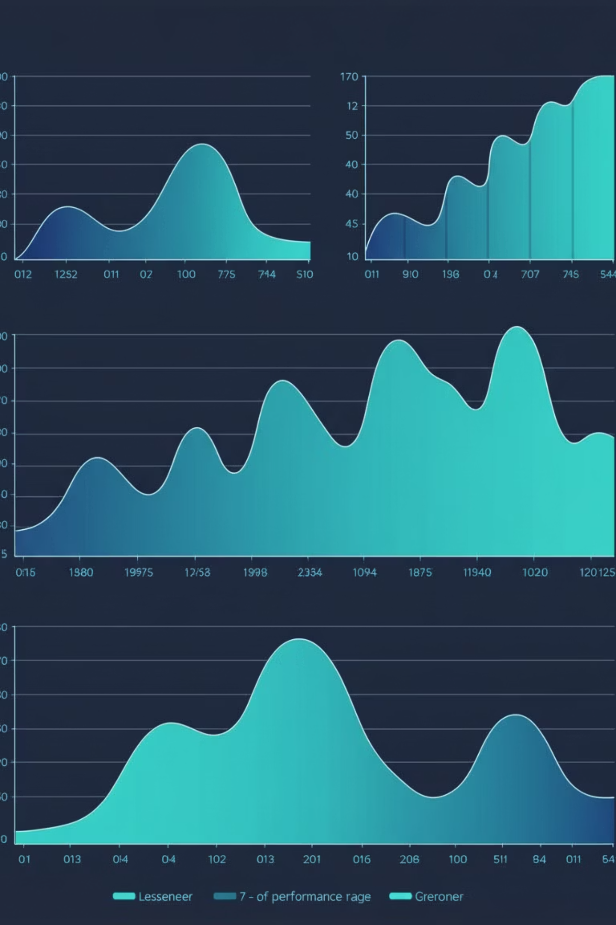
Future Horizons: Enhancing Fraud Detection
01
Real-time Monitoring
Implement streaming data processing for immediate fraud alerts.
02
Advanced Feature Engineering
Explore network analysis and external data sources to enrich features.
03
Feedback Loop Integration
Incorporate investigator feedback to continuously refine model performance.
04
Explainable AI (XAI)
Develop tools to provide transparency into model decisions for better understanding and trust.

Slide 19

THANK YOU
Any Questions?

